Slide 1
AIRPORT BUDDY
Team Name: Virtual Travellers
Saurabh
Yashwardhan Parakh
Madhup Prakash

Slide 2
Problem Statement
Every airport in the world is different from each other. Airports are usually very confusing and a tricky place to navigate through.
Consider reaching at an airport for the first time.
People reach airport early and end up waiting near boarding gate
Sign boards exists but there’s a wide array of information to absorb while hustling through different people from different cultures and carts while dragging your luggage
Also language awareness is major barrier in consuming sign boards
The CPP (Life Assitance company) survey data shows that 42% of people report the airport makes them feel stressed.
Navigating efficiently around the airport, from point A to point B

Slide 3
Why Augmented Reality
AR is likely to present an entirely new way to engage with the ever-evolving wireless technology, enabling the integration of mobile devices and appliances, to provide an enhanced connected experience for the end-users.
Users continuously lookout for some visual way of directing/teaching themselves through the loops of airport structures.

Slide 4
Scenario
The user has reached the airport and might need help in navigating through the airport.
Starting from check-in to departure gate to the seat in the plane.
User wants to explore duty free shopping areas

Slide 5
User Journey
Alert Notification
Travel to Airport
Check-In
Security Check
Shopping and other assistance
Board and Depart

Slide 6

Way to Satish Mani Cabin

Slide 7
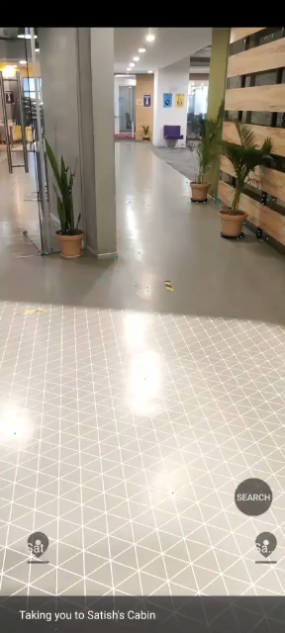
Way to Sanjay Mohan’s Cabin

Slide 8

.

